Slide 1
Salary projections: competitive & growing
Melissa Nooney

Slide 2
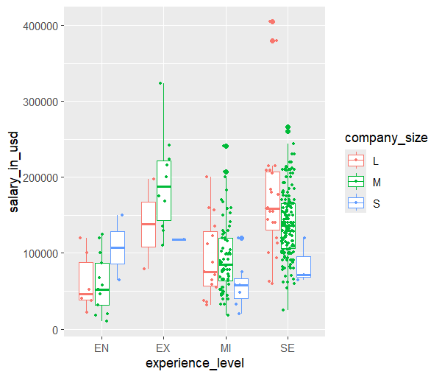
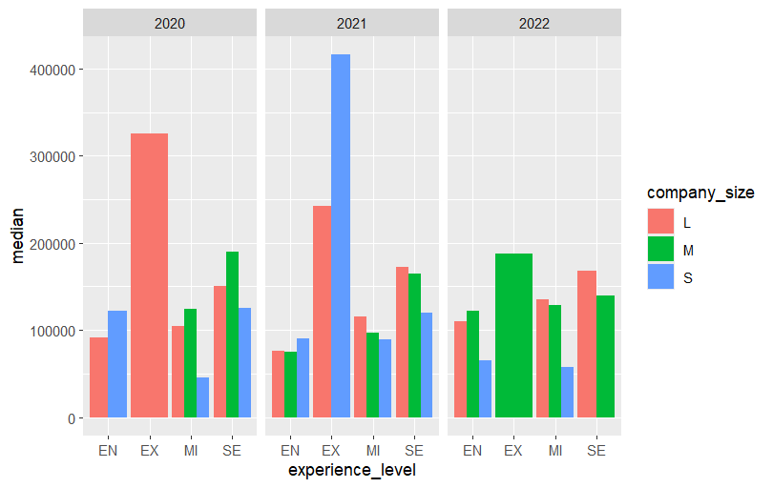
Breakdowns
2022 Salary Majorities
Overall Picture of Past Salaries
Notes:
Lots of takeaways here….We have our overall big picture numbers, but then by company size we can see a few things. Listed are medians and maxes. While some of the maxes fall within range, we can see our larger dots as outliers. Our large company max is actually an outlier, so we know for projections, that is not a realistic wage…competitive yes, but not realistic. Looking upon company growth, going into a medium sized company, the majority of employees are mid and senior level.

Slide 3
Salary recommendations
Current Needs: *
Inflation and Cost of Living
As a small company to stay competitive, these are your recommended pay ranges:
Entry: $49k - $133k / $80k avg
Mid-Level:
$62k- $102k/ $89k avg
Senior:
$104k - $146k/ $109 avg
Inflation rates for 2023: 4.1% average
Inflation rates 2024: 2.4% projected
Cost of Living Adjustment 2024: 8.7% expected
To stay competitive, you must increase salaries by a total of 15.2% from 2022 rates

Slide 4





Team growth Top 5 positions
Data Engineer
Data Scientist
Data Analyst
Machine Learning Engineer
Data Architect
MIDLEVEL
$76K-$113K AVG: $90K
SENIOR
$125K-$184K
AVG: $156K
MIDLEVEL
$83K-150K AVG: $115K
SENIOR
$146K-$212K
AVG: $167K
MIDLEVEL
$51K-$125K AVG: $68k
SENIOR
$105K-$149K
AVG: $130K
Data for senior levels only
SENIOR
$169K-$242K
AVG: $222K
MIDLEVEL
$107K-$128K AVG: $113K
SENIOR
$190K-$228K
AVG: $218k
Notes:
Going from a small company to a medium company, these are the top 5 positions and the salaries associated with experience levels, adjusted for inflation.

